Slide 1

ICS 370 Summer 2020 Team Name: group 4
Team Members: Mohamed Hashi, MEYGAN Schroeder, Kennedy Omweri
Project title: Gaming Engine Software Design
Elaboration Phase 2

Slide 2
Table of Contents
Introduction
Vision
Timeline
Scope
Business Value
Feasibility Studies
Software Development Methodology
Proposed System Functionalities
Use Cases, Goals & Risks
Updated Diagram
Data Model
Contracts
Hardware and Software Requirements

Slide 3
Introduction
After receiving feedback from users, we conducted a few more meetings, we decided to specify upon the capabilities of the gaming engine. It includes more details about platforms.
The Gaming Engine Software Design project is a project to develop an online gaming software application in which one or more players can play a game together or by themselves.
The purpose of this document is to begin coding the front and back ends of the gaming engine, set ideas for beta testing timelines, and refine the software design. It focuses on the capabilities needed by the stakeholders and the targeted users.

Slide 4
Vision
Our vision is to transform the way people play games. The experience will include online and offline gaming capabilities that can be utilized with other players virtually anywhere on any platform. As games progress when they are created, the engine will be able to connect players from all consoles such as Play Station's, Xbox’s, PC’s and VR thus allowing a huge catalog of games.

Slide 5
Timeline
July 20th – Upon user feedback, we narrowed down the needs of the community to better the operation of the gaming engine.
July 21st – Began coding for the front end and back end utilizing 2 separate teams.
July 22nd – Begin brainstorming and coding for the front end.
July 23rd – Begin brainstorming and coding for the back end.
July 24th – Test functionality of the front and back ends.
July 25th – Debug any issues and move forward with GUI

Slide 6

Scope
The scope of the project allows the players to search, buy and play variety of games by oneself, or with a group of users, all in one service.

Slide 7
Business value
The business value of the project is to minimize the time needed to design, develop the application.
Rent/Buy servers to run the online portion of gaming.

Slide 8

Feasibility Studies
Areas to be analyzed for feasibility studies include:
Requirements
Pricing
Technical, organization, cultural and legal Issues
Schedule of the project
The software gaming industry is making millions of dollars in profit and creating many hours of fun.
After carrying out a feasibility study a decision was arrived to go a head with the Gaming Engine Software Design system project.

Slide 9
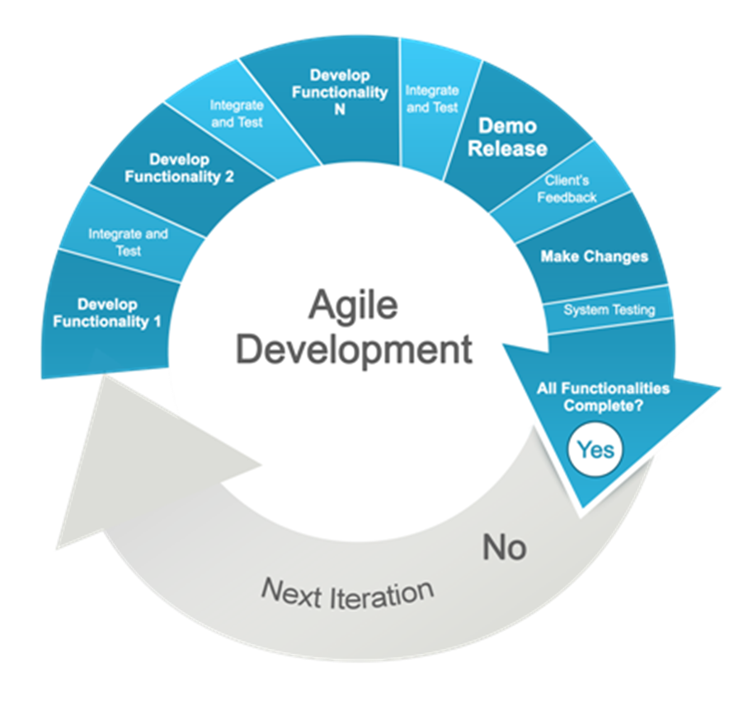
Software development methodology
Our team will be using Agile Software Development Metrology for this project
Iterative development allows us minimize mistake and maximize the ability to improve with each iteration.
Improve product quality
Focus on Business Value
Allow us to make changes in any phase

Slide 10

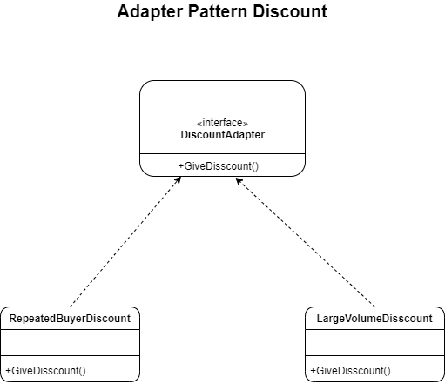
All discounts are similar in that they give players discount but each one could be changed without affecting other discounts.
A player could buy large amount of games and be a frequent buyer.

Slide 11
Proposed System Functionalities
Downloadable content will be available on the engine wherever you login.
Must download content to OS in order to utilize content
Downloadable content is able to be purchased as a gift for another user
Chat rooms are available for user communication to include voice control in and out of games
Automatic updates to the engine and downloaded content will automatically begin upon system login
Users are able to play with other users on private and public servers

Slide 12
Use Case
We implemented a key architecturally significant scenario of Process Login, Select Game use cases in the early stage i.e. selecting the preferred game from the catalog and receiving the requested game.
Implemented a happy path scenario and the design and implementation to support the key architectural scenario.
No collaboration with external services like product database.
Design and implement to support UP and database.

Slide 13
Goals
All groups to coordinate with other groups to fulfill their schedule.
Keep groups small enough to meet scheduling time constraints
Our highest priority is to satisfy the customer through early and continuous delivery of valuable software.
Welcome changing requirements even late in the development of customer's competitive advantage.
Working together as a team through collaboration.
Face-to-face conversation as the most effective method of conveying information with development teams
Counter competitive pressures and manufacturers in the new development area

Slide 14
Risks
Risks include both technical complexity factors such as uncertainty of effort and usability.
Focus on addressing the critical risks early in the project life to meet the schedule
Greatest risks are prioritized and addressed first.

Slide 16
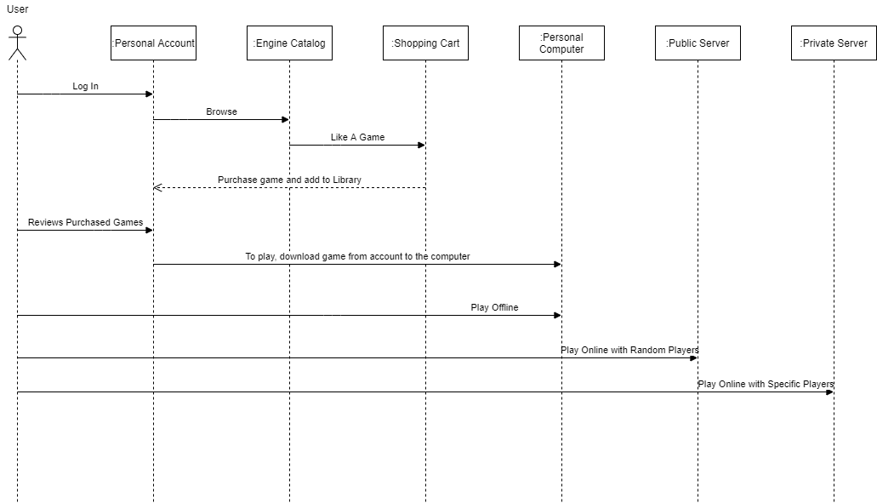
System Sequence Diagram

Slide 17

Actors use case
Actor | Use Cases
Player | Login Search games View games Update games Add games Make payment Play game Logout
Admin | Login Search games Add/Delete games Edit games Receive payment Logout
Payment System | Accept authorized payment information i.e. Credit card or PayPal

Slide 18
Data Model
Class | Attributes | Data Types
Player | accountNumber UserName playerRating creationDate | Int varchar(40) varchar(40) date
Search Games | gameID gameName gameSize gameType gamePrice | Int varchar(40) Int varchar(40) decimal(6,2)
Payment | PayPal Credit_card | Int int

Slide 19
Hardware and software requirements
On Windows | Minimum | Recommended
OS | Windows 7 (64 bit) or Newer (64 bit) Windows OS | Windows 7 (64 bit) or Newer (64 bit) Windows OS
Processor | 2.5 GHz Dual Core | 3.0+ GHz Dual Core
Memory | 4 GB RAM | 8 GB RAM
Graphics | NVIDIA GeForce GTX 760, AMD Radeon R9 270X, or better | NVIDIA GeForce GTX 1060, AMD Radeon R9 470X, or better
DirectX | DirectX Version 11.0 | DirectX Version 11.0
Network | Broadband Internet connection | Broadband Internet connection
Storage | 20 GB available space | 20 GB available space
Additional |  | Gamepad or Controller
On macOS | Minimum | Recommended
OS | macOS X 10.8.5 | macOS X 10.8.5 or Newer
Processor | Intel Core i5 2.4 GHz | Intel Core i7 2.4 GHz+
Memory | 8 GB RAM | 8 GB RAM
Graphics | OpenGL 4.1 - ATI Radeon HD 5670, NVIDIA GeForce GT 640M,bIntel HD Graphics 4000, or Iris Pro Graphics | OpenGL 4.1 - ATI Radeon HD 5670, NVIDIA GeForce GT 640M, Intel HD Graphics 4000, or Iris Pro Graphics
Network | Broadband Internet connection | Broadband Internet connection
Storage | 5 GB available space | 5 GB available space
Additional |  | Gamepad or Controller

Slide 20
Discount adapter pattern

